Slide 1
Mindfulness-Based Interventions (MBIs) for Reducing Anxiety
Student Name
Course Code
University Name
Prof.
Submission Date
Notes:
Good Morning Everyone. Today I am going to present the topic “Mindfulness-Based Interventions (MBIs) for Reducing Anxiety”
This presentation explores the integration of Mindfulness-Based Interventions (MBIs), including MBSR and MBCT, as evidence-based strategies for managing anxiety in adults. We will address the clinical issue of anxiety, propose MBIs as a non-invasive solution, and analyze dissemination strategies for implementing this change in practice. Lastly, we will discuss potential barriers and methods to overcome them.

Slide 2

Clinical Issue of Interest
Title: Anxiety in Adults
Anxiety disorders impact 1 in 5 adults globally
Over-reliance on pharmacological interventions
Need for holistic, evidence-based solutions
(Fumero et al., 2020)
Notes:
Anxiety is one of the most common mental health disorders, affecting nearly 20% of adults worldwide. Current treatment often depends on medication, which may have side effects or limited accessibility. Mindfulness-Based Interventions (MBIs) present an alternative, offering a holistic, flexible, and evidence-backed approach to managing anxiety symptoms effectively.

Slide 3

Evidence-Based Practice Change
Focus on mindfulness practices like MBSR and MBCT
Train healthcare providers in mindfulness techniques
Integrate MBIs into anxiety treatment plans
(Fumero et al., 2020)
Notes:
The proposed practice change involves incorporating Mindfulness-Based Stress Reduction (MBSR) and Mindfulness-Based Cognitive Therapy (MBCT) into anxiety management strategies. These interventions teach mindfulness practices, such as meditation and breathing exercises, to reduce symptoms of anxiety effectively. Training healthcare providers ensures seamless integration into existing treatment plans.

Slide 4

Evidence Supporting MBIs
Reduce anxiety without medication
Comparable or superior to pharmacological care
Adaptable to clinical and non-clinical settings
(Chuntana Reangsing et al., 2023)
Notes:
MBIs are proven effective through multiple studies, showing significant reductions in anxiety symptoms. Unlike pharmacological treatments, MBIs are non-invasive, have no side effects, and can be personalized to individual needs. Their adaptability makes them valuable for both clinical and non-clinical applications, ensuring wide applicability.

Slide 5

Preferred dissemination strategy: workshops and training programs
Hands-on training for healthcare providers
Interactive learning for better retention
Immediate feedback and skill-building
(Odgers et al., 2020)
Notes:
Workshops and training sessions are an effective dissemination strategy for MBIs. They allow healthcare providers to engage in hands-on learning, practice techniques, and receive immediate feedback. This interactive approach ensures that providers are well-equipped to integrate MBIs into their practice effectively.

Slide 6

Preferred Dissemination Strategy: Digital Learning Platforms
Accessible and flexible training modules
Cost-effective for large-scale adoption
Continuous learning opportunities
(Oberoi et al., 2020)
Notes:
Digital platforms offer accessible, scalable solutions for disseminating information about MBIs. Online training modules allow providers to learn at their own pace and revisit material as needed, promoting continuous education. These platforms are especially cost-effective, making them ideal for large organizations.

Slide 7

Least Preferred Dissemination Strategy: Email Campaigns
Lack of engagement and interaction
Limited depth of information
Low participation rates
(Oberoi et al., 2020)
Notes:
While email campaigns can disseminate information quickly, they lack the interactive and engaging elements required for training on MBIs. The static nature of emails often results in limited comprehension and poor participation, making them less effective for evidence-based practice changes.

Slide 8

Least Preferred Dissemination Strategy: Posters and Flyers
Insufficient detail for complex topics
Minimal impact on behavior change
Low engagement in healthcare settings
(Fumero et al., 2020)
Notes:
Posters and flyers, while visually appealing, fail to provide the comprehensive information needed for adopting MBIs. These materials are better suited for awareness campaigns rather than training, as they lack the depth and interaction necessary to effect meaningful change.

Slide 9
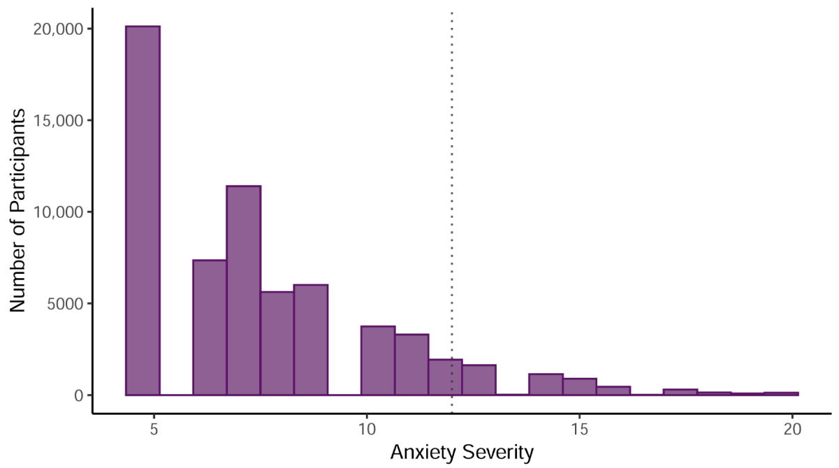
Barriers to Dissemination
  Resistance to change among staff
  Limited understanding of MBIs
  Budgetary constraints for training
  Challenges in Implementation
(Chuntana Reangsing et al., 2023)
Notes:
Implementing MBIs can face resistance from staff unfamiliar with mindfulness practices or skeptical about their efficacy. Additionally, limited budgets may hinder the availability of training resources, creating barriers to widespread adoption in healthcare settings.

Slide 10
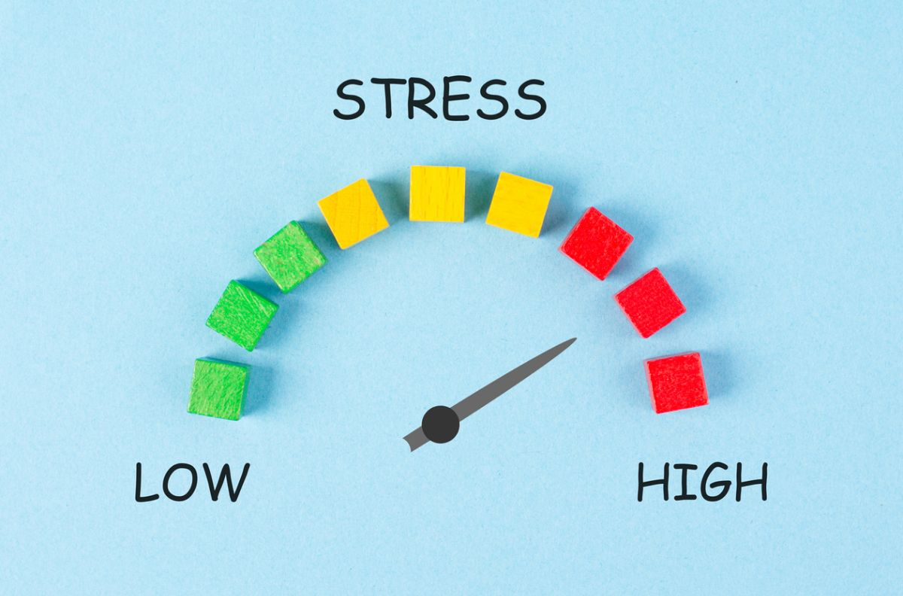
Overcoming Barriers
Building Awareness and Engagement
Early involvement of staff in planning.
Share evidence supporting MBIs’ effectiveness.
Provide incentives for participation.
(Odgers et al., 2020)
Notes:
Engaging staff early in the planning process fosters a sense of ownership and reduces resistance. Providing evidence of MBIs’ effectiveness builds confidence, while incentives such as professional development credits encourage participation in training programs.

Slide 11

Overcoming Barriers
Managing Resource Constraints
Leverage free or low-cost digital tools
Apply for grants to fund training
Pilot MBIs in smaller settings for scalability
(Chuntana Reangsing et al., 2023)
Notes:
Resource constraints can be mitigated by utilizing cost-effective digital tools and seeking external funding through grants. Starting with pilot programs allows organizations to demonstrate MBIs’ success and justify further investment for broader implementation.

Slide 12
Conclusion
MBIs are effective and flexible for managing anxiety
Strategic dissemination ensures successful implementation
Addressing barriers promotes long-term success
Notes:
MBIs are a powerful, evidence-based tool for managing anxiety. Strategic dissemination and addressing potential barriers are critical for successful implementation. With proper planning and support, MBIs can transform anxiety management in healthcare settings.

